Slide 1
Announcements
Homework 6 is out
Due on May 27th (same date as the original final exam)
No arXiv link!
Course evaluations
On top of your Canvas
Notes:
Dr. Kevin Guidry

Slide 2
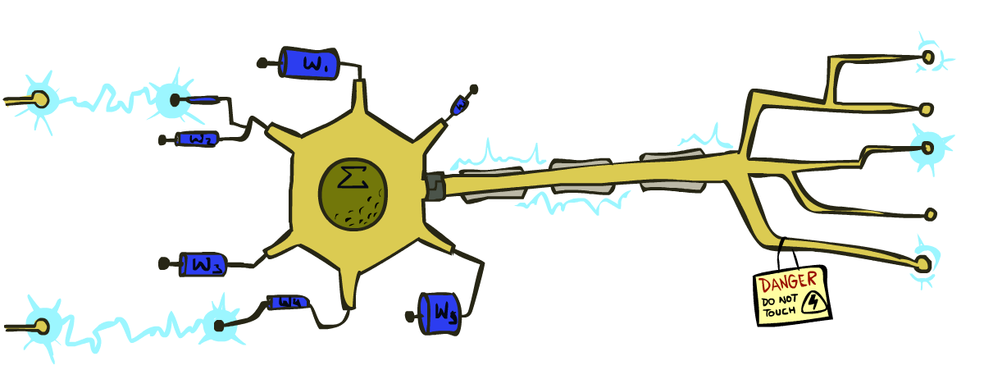
Intro to Dear AI
Perceptron and Logistic Regression
Instructor: Rahmat Beheshti
With slides from Dan Klein and Pieter Abbeel at UC Berkeley (ai.berkeley.edu)

Slide 3
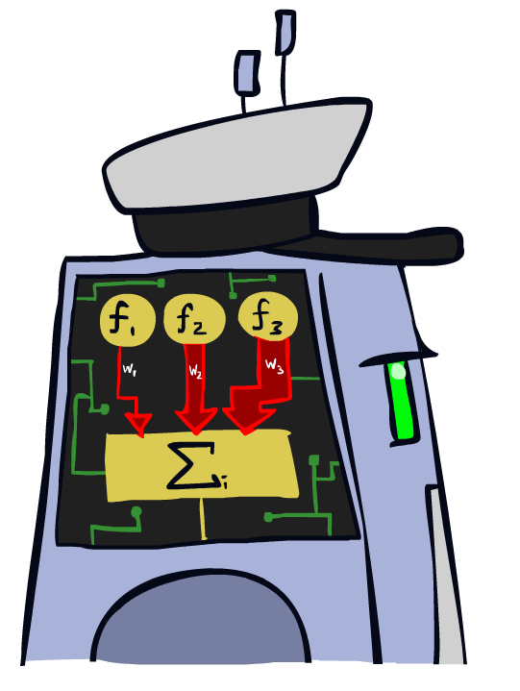
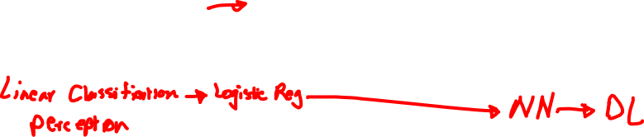
Linear Classifiers

Slide 4
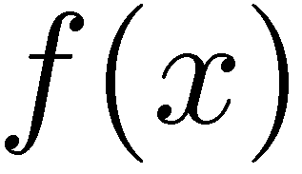



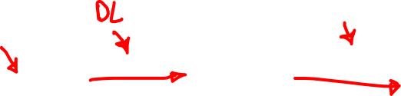
Feature Vectors
Hello,
Do you want free printr cartriges? Why pay more when you can get them ABSOLUTELY FREE! Just
# free : 2
YOUR_NAME : 0
MISSPELLED : 2
FROM_FRIEND : 0
...
SPAM
or
+
PIXEL-7,12 : 1
PIXEL-7,13 : 0
...
NUM_LOOPS : 1
...
“2”

Slide 5
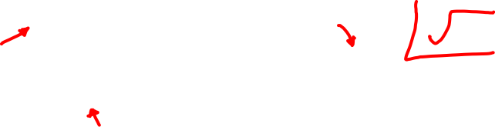
Some (Simplified) Biology
Very loose inspiration: human neurons

Slide 6
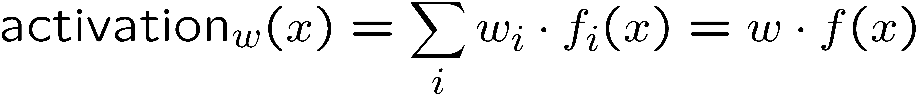
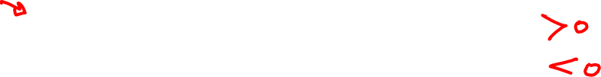
Linear Classifiers
Inputs are feature values
Each feature has a weight
Sum is the activation
If the activation is:
Positive, output +1
Negative, output -1
w₁
f₁
Σ
w₂
>0?
f₂
w₃
f₃

Slide 7


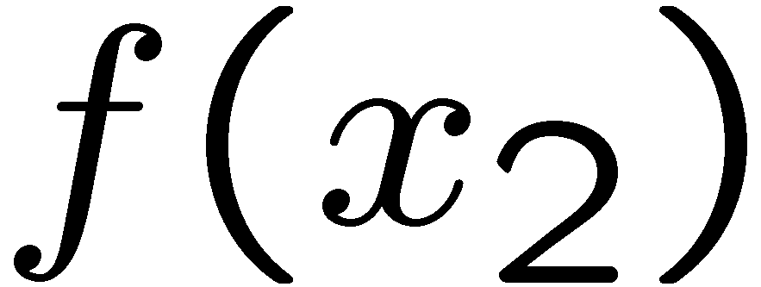
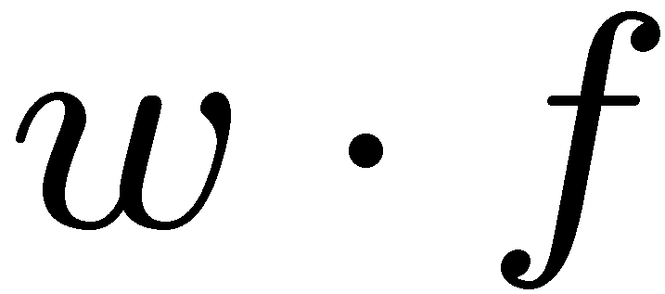
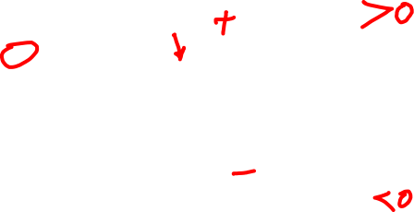
Weights
Binary case: compare features to a weight vector
Learning: figure out the weight vector from examples
# free : 4
YOUR_NAME :-1
MISSPELLED : 1
FROM_FRIEND :-3
...
# free : 2
YOUR_NAME : 0
MISSPELLED : 2
FROM_FRIEND : 0
...
# free : 0
YOUR_NAME : 1
MISSPELLED : 1
FROM_FRIEND : 1
...
Dot product positive means the positive class

Slide 8
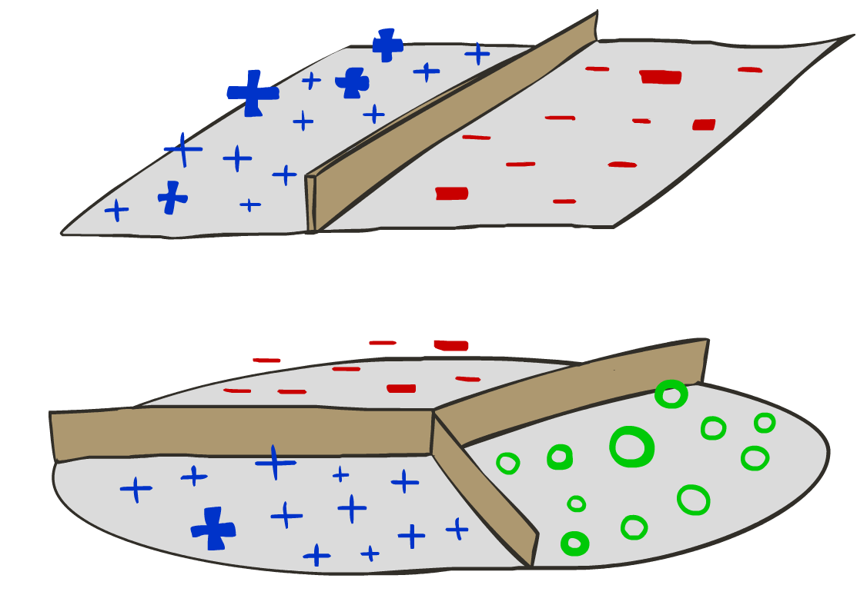
Decision Rules

Slide 9

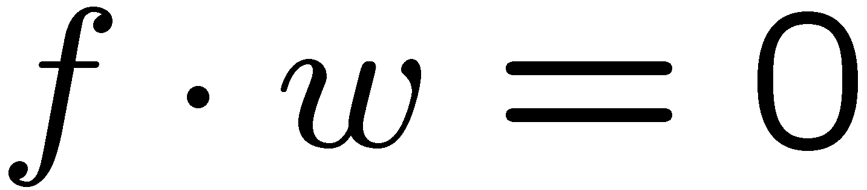
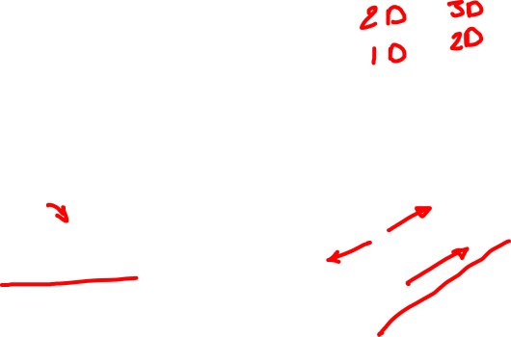
Binary Decision Rule
In the space of feature vectors
Examples are points
Any weight vector is a hyperplane
One side corresponds to Y=+1
Other corresponds to Y=-1
money
2
+1 = SPAM
1
BIAS : -3
free : 4
money : 2
...
0
-1 = HAM
0
1
free

Slide 10

Weight Updates

Slide 11
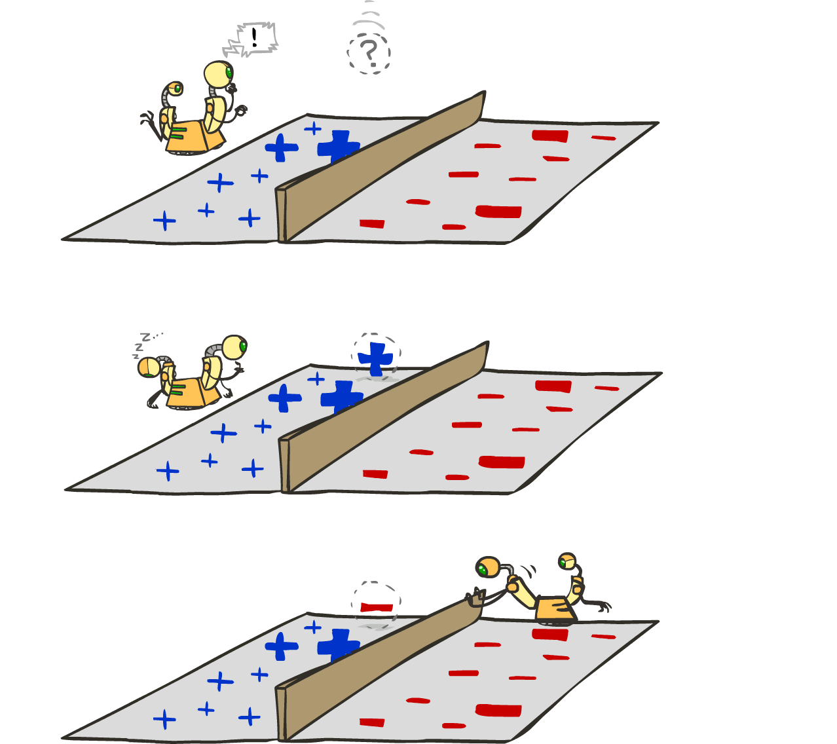

Learning: Binary Perceptron
Start with weights = 0
For each training instance:
Classify with current weights
If correct (i.e., y=y*), no change!
If wrong: adjust the weight vector
Notes:
http://isl.ira.uka.de/neuralNetCourse/2004/VL_11_5/Perceptron.html

Slide 12
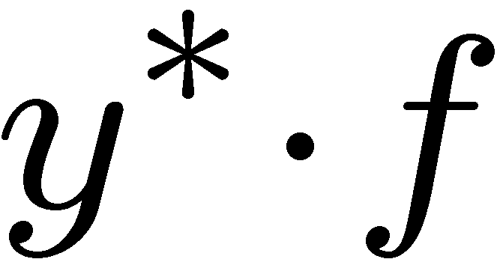
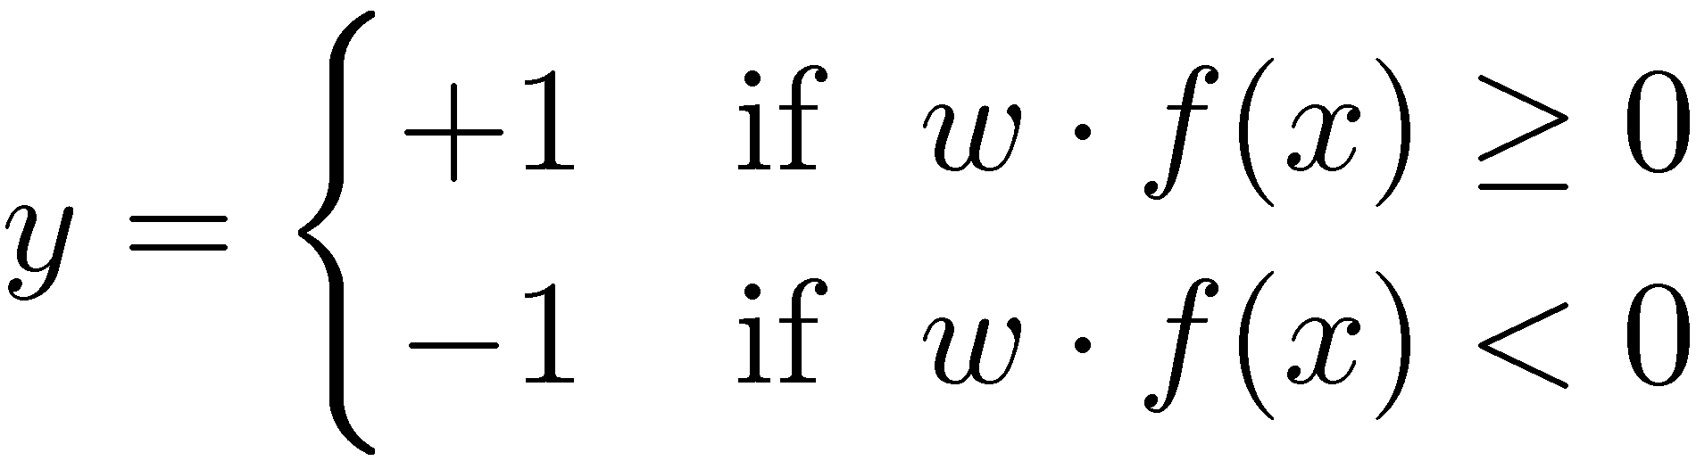

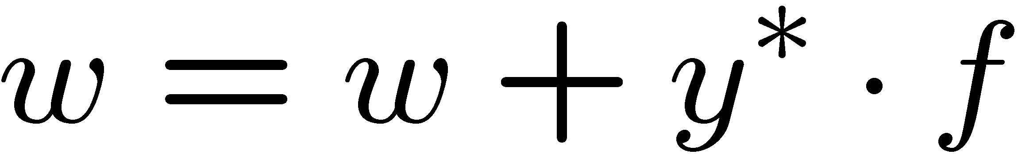
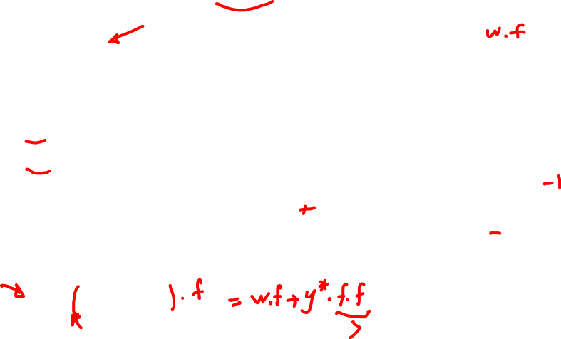
Learning: Binary Perceptron
Start with weights = 0
For each training instance:
Classify with current weights
If correct (i.e., y=y*), no change!
If wrong: adjust the weight vector by adding or subtracting the feature vector. Subtract if y* is -1.
Notes:
http://isl.ira.uka.de/neuralNetCourse/2004/VL_11_5/Perceptron.html

Slide 13
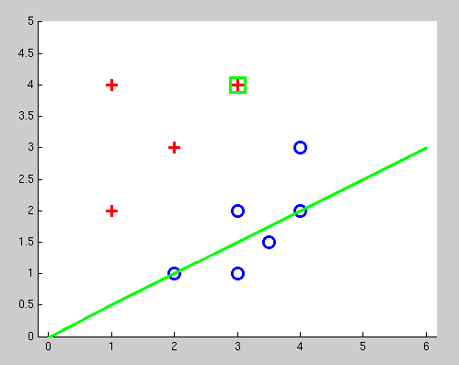
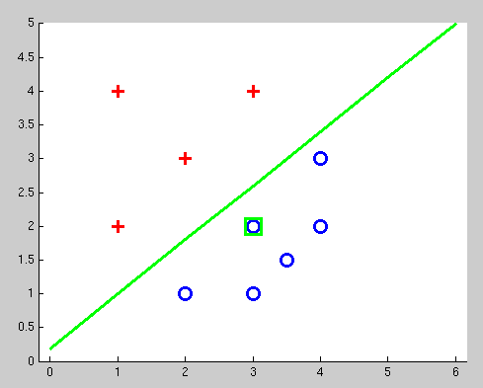
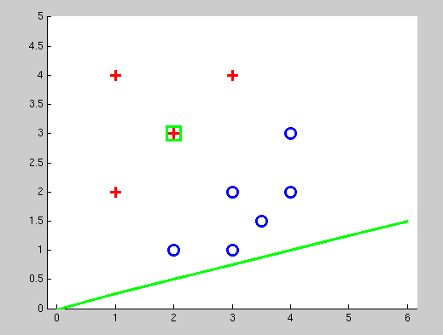
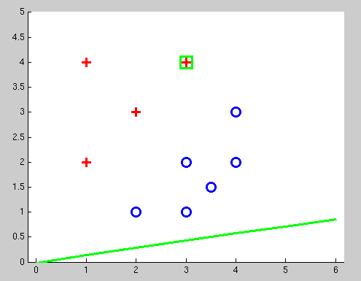

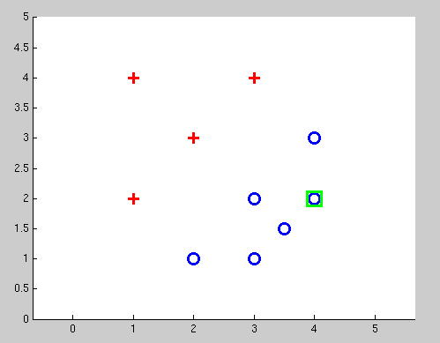
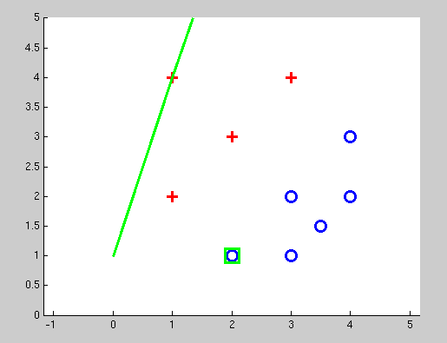
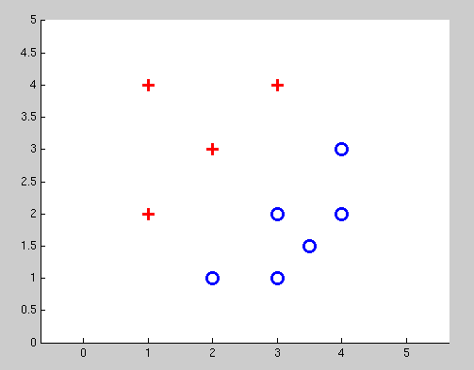
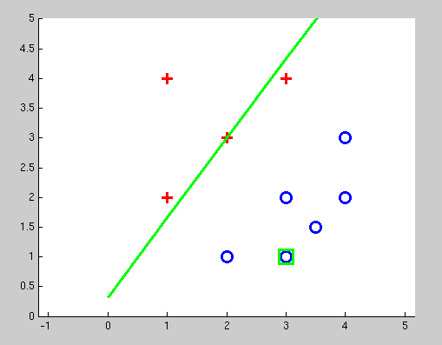
Examples: Perceptron
Separable Case

Slide 14

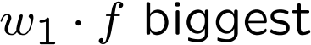
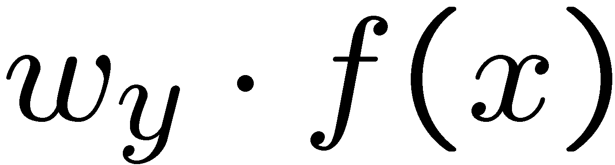



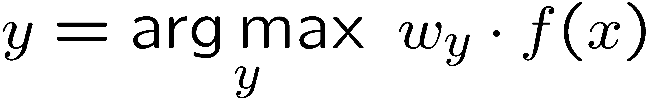
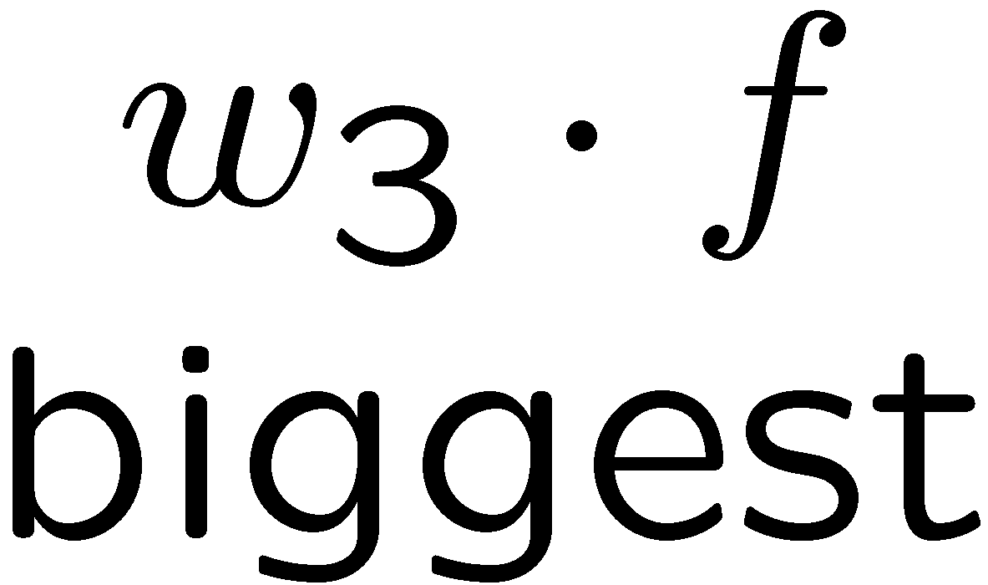
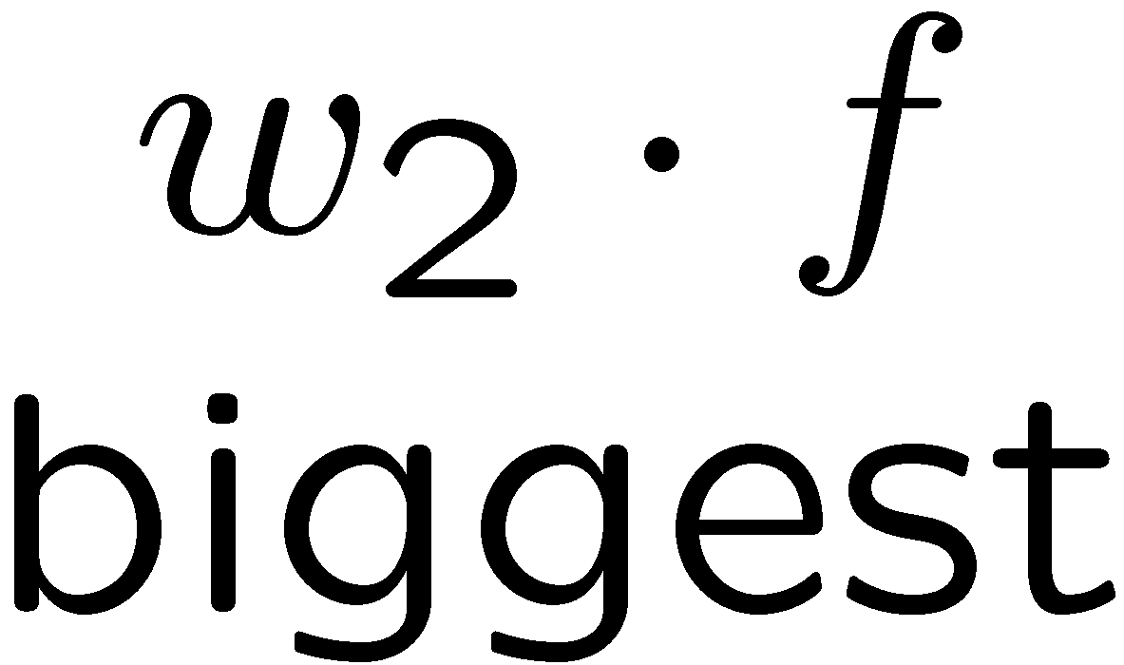
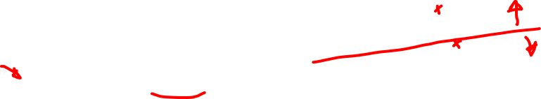
Multiclass Decision Rule
If we have multiple classes:
A weight vector for each class:
Score (activation) of a class y:
Prediction highest score wins
Binary = multiclass where the negative class has weight zero

Slide 15



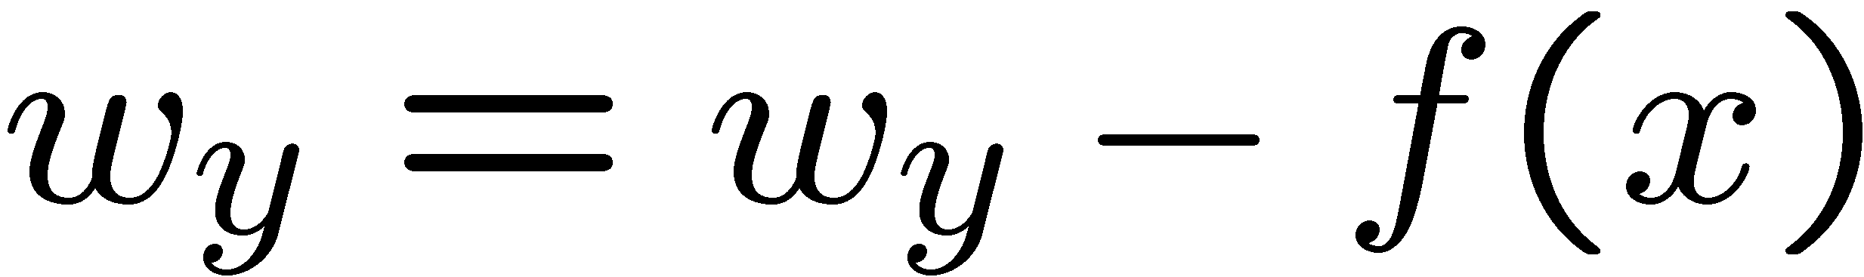
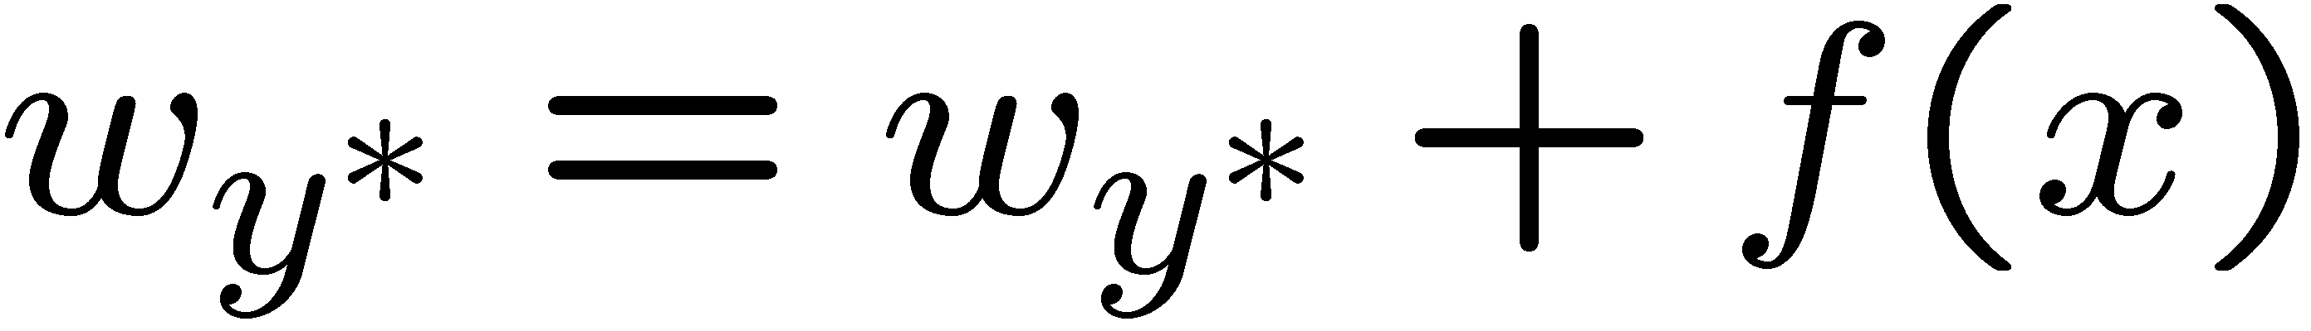
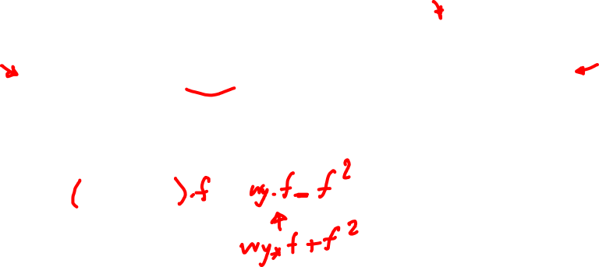
Learning: Multiclass Perceptron
Start with all weights = 0
Pick up training examples one by one
Predict with current weights
If correct, no change!
If wrong: lower score of wrong answer, raise score of right answer

Slide 16
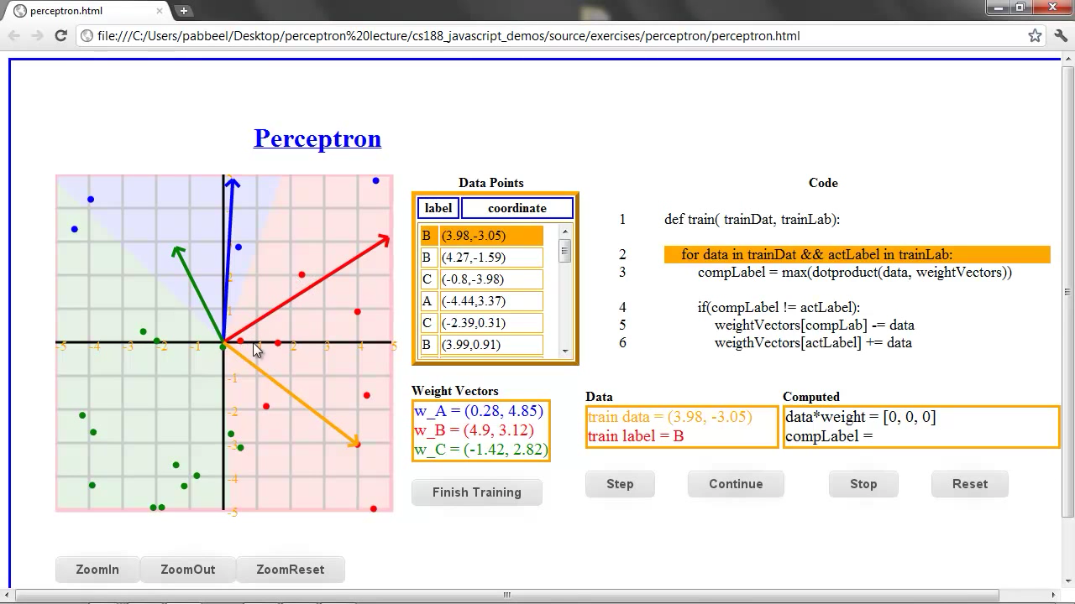

Slide 17



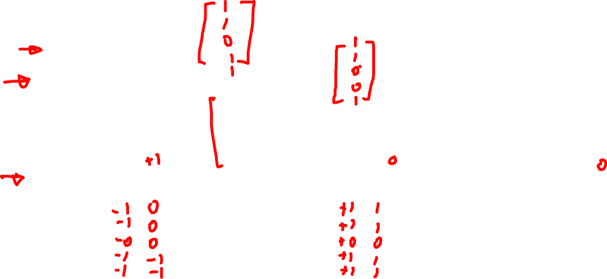
Example: Multiclass Perceptron
“win the vote”
“win the election”
“win the game”
BIAS : 1
win : 0
game : 0
vote : 0
the : 0
...
BIAS : 0
win : 0
game : 0
vote : 0
the : 0
...
BIAS : 0
win : 0
game : 0
vote : 0
the : 0
...

Slide 18
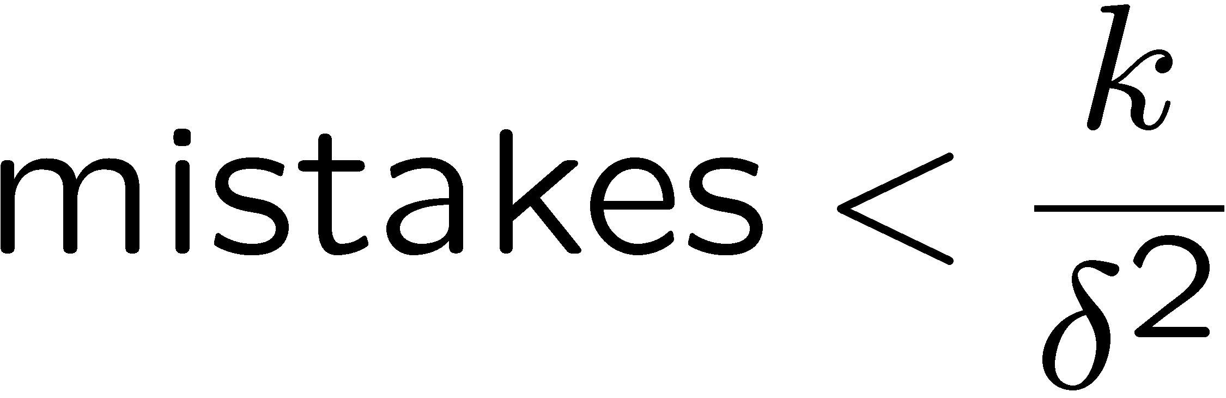
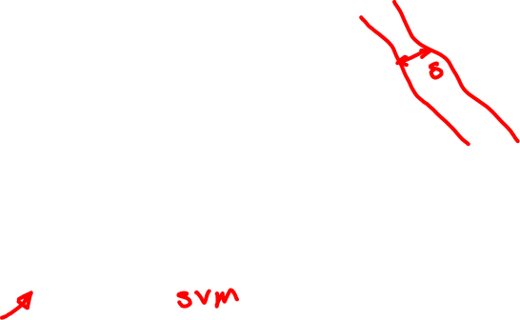
Properties of Perceptrons
Separable
Separability: true if some parameters get the training set perfectly correct
Convergence: if the training is separable, perceptron will eventually converge (binary case)
Mistake Bound: the maximum number of mistakes (binary case) related to the margin or degree of separability
Non-Separable

Slide 19
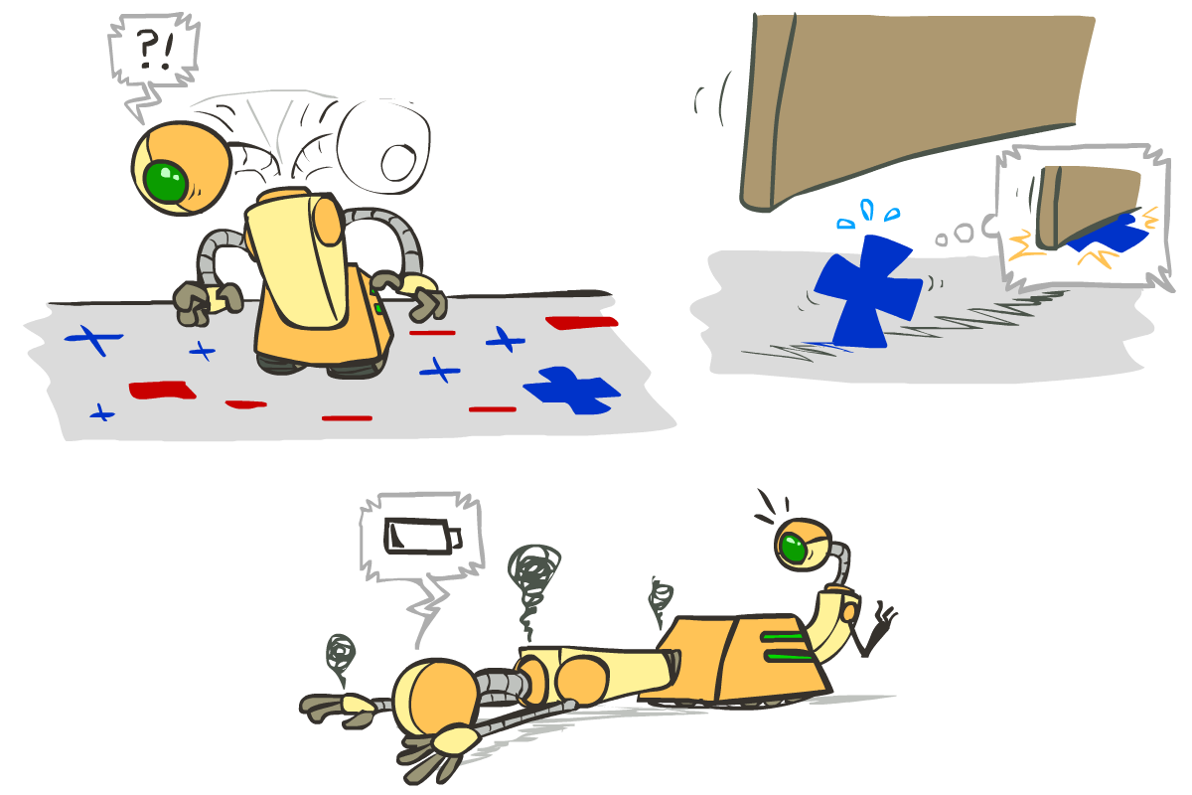






Problems with the Perceptron
Noise: if the data isn’t separable, weights might thrash
Averaging weight vectors over time can help (averaged perceptron)
Mediocre generalization: finds a “barely” separating solution
Overtraining: test / held-out accuracy usually rises, then falls
Overtraining is a kind of overfitting

Slide 20
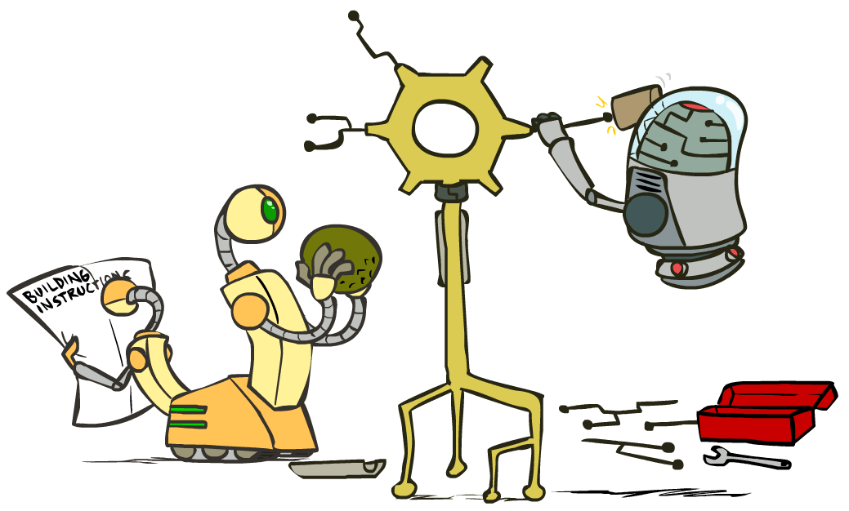
Improving the Perceptron

Slide 21
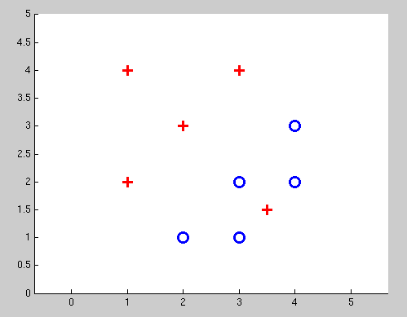
Non-Separable Case: Deterministic Decision
Even the best linear boundary makes at least one mistake

Slide 22
Non-Separable Case: Probabilistic Decision
0.9 | 0.1
0.7 | 0.3
0.5 | 0.5
0.3 | 0.7
0.1 | 0.9

Slide 23
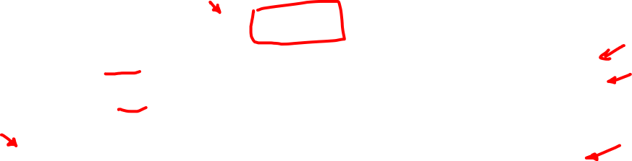
How to get probabilistic decisions?
Perceptron scoring:
If very positive → want probability going to 1
If very negative → want probability going to 0
Sigmoid function

Slide 24
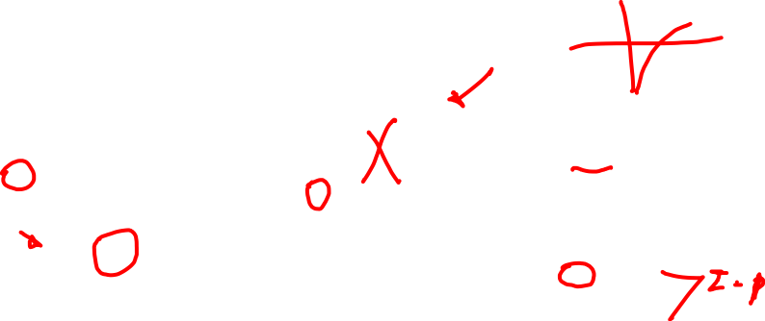
Best w?
Maximum likelihood estimation:
with:
= Logistic Regression

Slide 25
Separable Case: Deterministic Decision – Many Options

Slide 26
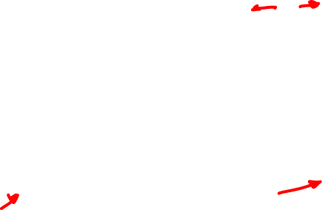
Separable Case: Probabilistic Decision – Clear Preference
0.7 | 0.3
0.5 | 0.5
0.7 | 0.3
0.3 | 0.7
0.5 | 0.5
0.3 | 0.7

Slide 27
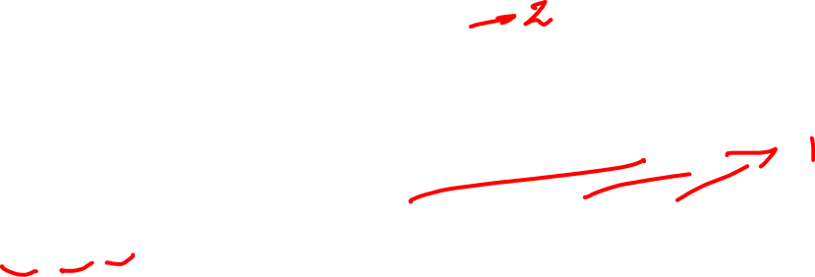
Multiclass Logistic Regression
Recall Perceptron:
A weight vector for each class:
Score (activation) of a class y:
Prediction highest score wins
How to make the scores into probabilities?
original activations
softmax activations

Slide 28

Best w?
Maximum likelihood estimation:
with:
= Multi-Class Logistic Regression

Slide 29

Problem formulation
Optimization
i.e., how do we solve:

Slide 30
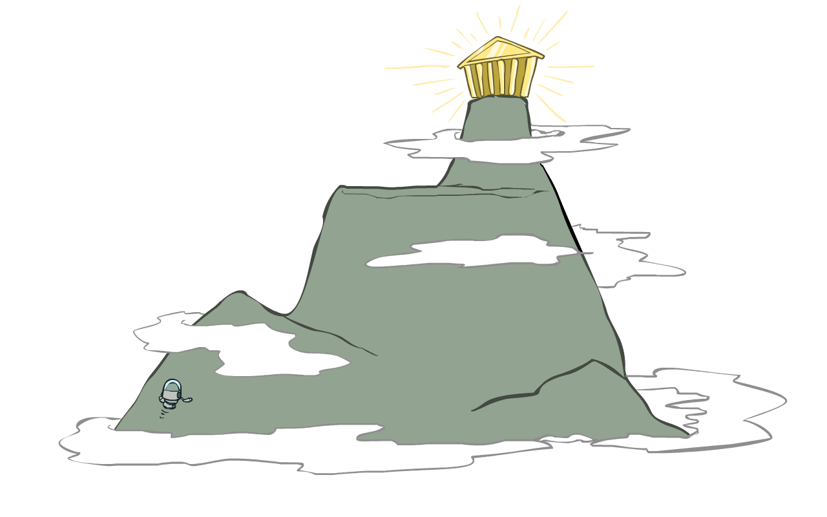
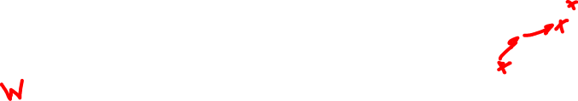
Hill Climbing
Recall from CSPs lecture: simple, general idea
Start wherever
Repeat: move to the best neighboring state
If no neighbors better than current, quit
What’s particularly tricky when hill-climbing for multiclass logistic regression?
Optimization over a continuous space
Infinitely many neighbors!
How to do this efficiently?

Slide 31
1-D Optimization
Could evaluate and
Then step in best direction
Or, evaluate derivative:
Tells which direction to step into

Slide 32
2-D Optimization
Source: offconvex.org

Slide 33
Gradient Ascent
Perform update in uphill direction for each coordinate
The steeper the slope (i.e. the higher the derivative) the bigger the step for that coordinate
E.g., consider:
Updates:
Updates in vector notation:
with:
= gradient

Slide 34
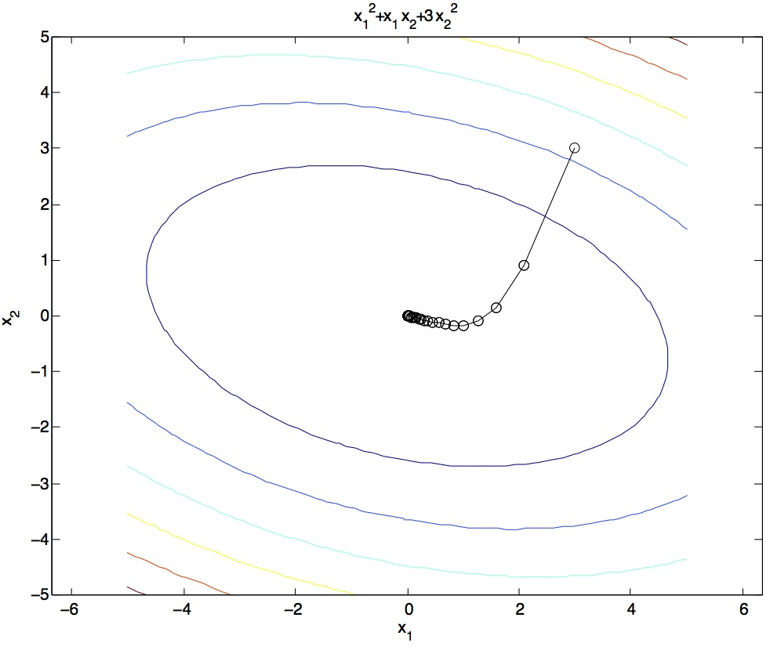
Gradient Ascent
Idea:
Start somewhere
Repeat: Take a step in the gradient direction
Figure source: Mathworks

Slide 35
What is the Steepest Direction?*
First-Order Taylor Expansion:
Steepest Descent Direction:
Recall: →
Hence, solution:
Gradient direction = steepest direction!

Slide 36
Gradient in n dimensions

Slide 37
Optimization Procedure: Gradient Ascent
init
for iter = 1, 2, …
: learning rate --- tweaking parameter that needs to be chosen carefully
How? Try multiple choices
Crude rule of thumb: update changes about 0.1 – 1 %

Slide 38
Batch Gradient Ascent on the Log Likelihood Objective
init
for iter = 1, 2, …

Slide 39
Stochastic Gradient Ascent on the Log Likelihood Objective
Observation: once gradient on one training example has been computed, might as well incorporate before computing next one
init
for iter = 1, 2, …
pick random j

Slide 40
Mini-Batch Gradient Ascent on the Log Likelihood Objective
Observation: gradient over small set of training examples (=mini-batch) can be computed in parallel, might as well do that instead of a single one
init
for iter = 1, 2, …
pick random subset of training examples J

Slide 41
How about computing all the derivatives?
We’ll talk about that once we covered neural networks, which are a generalization of logistic regression

Slide 42
Gradient Descent
Easier to understand than Gradient Ascent
Watch this:
https://www.youtube.com/watch?v=uJryes5Vk1o
Note the differences
x instead of f(x)
Additional bias term (b)

